Slide 1
Introduction to PIC I/O Ports + Hardware and circuits
Lecture3

Slide 2
Why Digital Input/Output?
Almost any embedded system needs to transfer digital data between its CPU and the outside world. This transfer falls into a few categories, which can be summarised as:
Direct user interface, including switches, keypads, light emitting diodes (LEDs) and displays;
Input measurement information, from external sensors, possibly being acquired through an analogue to digital converter;
Output control information, for example to motors or other actuators;
Bulk data transfer to or from other systems or sub-systems, moving in serial or parallel form, for example sending serial data to an external memory.
How can we provide the required interface between the microcontroller core and the outside world? More precisely, how do we get the data onto or off the data bus at the right moment?

Slide 3
Parallel Input/Output 2
We could apply a circuit like this for output.
Here a pulse on the Port Select line captures data on the bus at that instant and transfers it to the external pin.
Two lines of
Data Bus
Read/Write
D
Q
External Pin
Port Select
Flip-flop latches data bus value onto
high whenever
external pin, when memory location
port address is
is selected, AND Write is active
selected
D
Q
External Pin

Slide 4
Parallel Input/Output 2
Or we could apply a circuit like this for input.
Here a pulse on the Port Select line transfers data on the external pin at that instant to the data bus.
Two lines of
Data Bus
Read/Write
External Pin
Port Select
buffer transfers logic value on external pin
onto data bus line, when memory location
is selected, AND Read is active
External Pin

Slide 5
A Bi-Directional Port Pin Driver Circuit
Read/Write
Read/Write
Read Port
We could combine both circuits into one multi-function circuit, like this. You don’t need to grasp all the detail of this circuit, although it’s neat if you can.
There is now an extra flip-flop, labelled “Direction”. The state of this decides in which direction data will flow.
The two flip-flops shown can each form one bit in an SFR, which can be controlled from the CPU.
A group of these bits, each driven by a circuit like this, is called a “port”
Read Port
Data Bus
Data Bus
(bit n)
(bit n)
Input Buffer
Input Buffer
I/O Pin
"Data"
I/O Pin
"Data"
(bit n of an
Output Buffer
(bit n of an
Write
Output Buffer
Write
D
D
Q
Q
8
8
-
-
bit port)
Port
bit port)
Port Select
Port
Port Select
holds bit
holds bit
output value
output value
8 of these
8 of these
buffer, enabled
flip-flops form
buffer, enabled
flip
-
-
flops form
when pin is output
the "Data" SFR
when pin is output
the "Data" SFR
"Direction"
"Direction"
Write
Write
D
D
Q
DDR
Q
DDR
determines whether port
Direction Select
determines whether port
Direction Select
bit is input or output
bit is input or output
Alternate Input
Alternate Input
Function
Function
"Data" SFR
"Data" SFR
8 of these flip
8 of these flip
-
-
flops form
flops form
the "Data Direction" SFR
the "Data Direction" SFR
"Direction" SFR
"Direction" SFR

Slide 6
Electrical Circuits basics

Slide 7
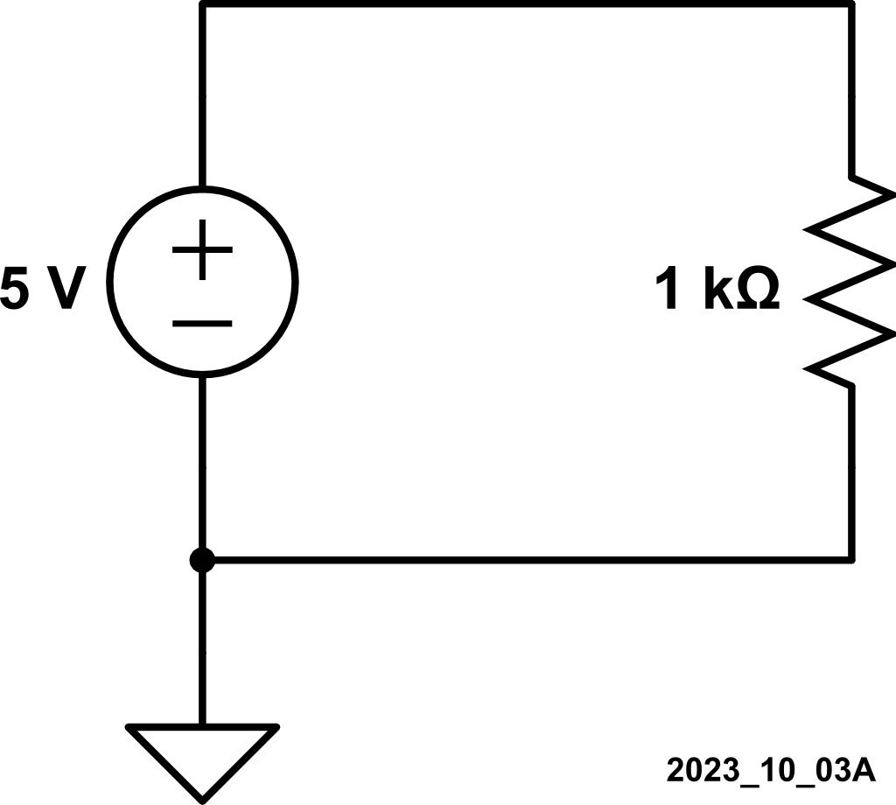
Reimagined Ohm’s Law: ΔV = IR
5mA = I
Positive current flows from a high potential to a low potential
ΔV_{pos to neg} = I_{into pos} R
I_{into pos} = ΔV_{pos to neg} / R
I_{into pos} = (5V – 0V) / 1kΩ = 5mA
5V
+
ΔV
–
0V

Slide 8
Voltage Sources Only Have One Job
R_{battery}
35Ω
I
All practical power supplies are NOT ideal voltage sources
5V
+
ΔV
–
0V

Slide 9
Voltage Sources Only Have One Job
R_{battery}
35Ω
4.83mA = I
All practical power supplies are NOT ideal voltage sources
I_{into pos} = ΔV_{pos to neg} / R
I_{into pos} = (5V – 0V) / (1kΩ + 35Ω )
I_{into pos} = 4.83mA
5V
+
ΔV
–
0V

Slide 10
Voltage Sources Only Have One Job
R_{battery}
35Ω
4.83mA = I
All practical power supplies are NOT ideal voltage sources
I_{into pos} = ΔV_{pos to neg} / R
I_{into pos} = (5V – 0V) / (1kΩ + 35Ω )
I_{into pos} = 4.83mA
V_{OUT} = (4.83mA)(1kΩ)
V_{OUT} = 4.83V
5V
4.83V
+
ΔV
–
0V

Slide 11
Voltage Sources Only Have One Job
R_{battery}
35Ω
4.83mA = I
All practical power supplies are NOT ideal voltage sources
I_{into pos} = ΔV_{pos to neg} / R
I_{into pos} = (5V – 0V) / (1kΩ + 35Ω )
I_{into pos} = 4.83mA
V_{OUT} = (4.83mA)(1kΩ)
V_{OUT} = 4.83V
Voltage Divider
5V
4.83V
+
ΔV
–
0V

Slide 12
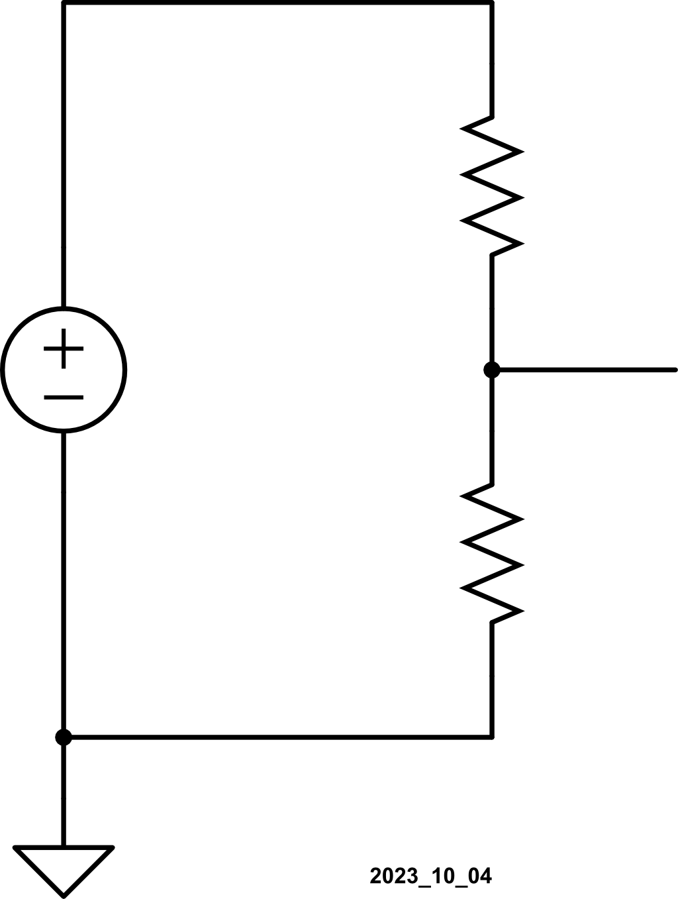
Kirchhoff’s Voltage Law:
What goes up, has to come down
V_{SUPPLY} = ΔV₁ + ΔV₂
+
ΔV₁
–
R₁
V_{SUPPLY}
+
ΔV₂
–
R₂

Slide 13
Kirchhoff’s Voltage Law:
I
What goes up, has to come down
V_{SUPPLY} = ΔV₁ + ΔV₂
Current goes into positive terminals
ΔV₁ = IR₁
ΔV₂ = IR₂
+
ΔV₁
–
R₁
V_{SUPPLY}
+
ΔV₂
–
R₂

Slide 14
Kirchhoff’s Voltage Law:
I
What goes up, has to come down
V_{SUPPLY} = ΔV₁ + ΔV₂ = IR₁ + IR₂
Current goes into positive terminals
ΔV₁ = IR₁
ΔV₂ = IR₂
+
ΔV₁
–
R₁
V_{SUPPLY}
+
ΔV₂
–
R₂

Slide 15
Kirchhoff’s Voltage Law:
I
What goes up, has to come down
V_{SUPPLY} = ΔV₁ + ΔV₂ = IR₁ + IR₂
Current goes into positive terminals
ΔV₁ = IR₁ = V_{SUPPLY} – V_{OUT}
ΔV₂ = IR₂ = V_{OUT} – 0V = V_{OUT}
V_{SUPPLY}
+
ΔV₁
–
R₁
V_{OUT}
V_{SUPPLY}
+
ΔV₂
–
R₂
0V

Slide 16
Kirchhoff’s Voltage Law:
I
What goes up, has to come down
V_{SUPPLY} = ΔV₁ + ΔV₂ = IR₁ + IR₂
Current goes into positive terminals
ΔV₁ = IR₁ = V_{SUPPLY} – V_{OUT}
ΔV₂ = IR₂ = V_{OUT} – 0V = V_{OUT}
Sources, too: V_{SUPPLY} = V_{SUPPLY} – 0V
V_{SUPPLY}
+
ΔV₁
–
–I
R₁
V_{OUT}
V_{SUPPLY}
+
ΔV₂
–
R₂
0V

Slide 17
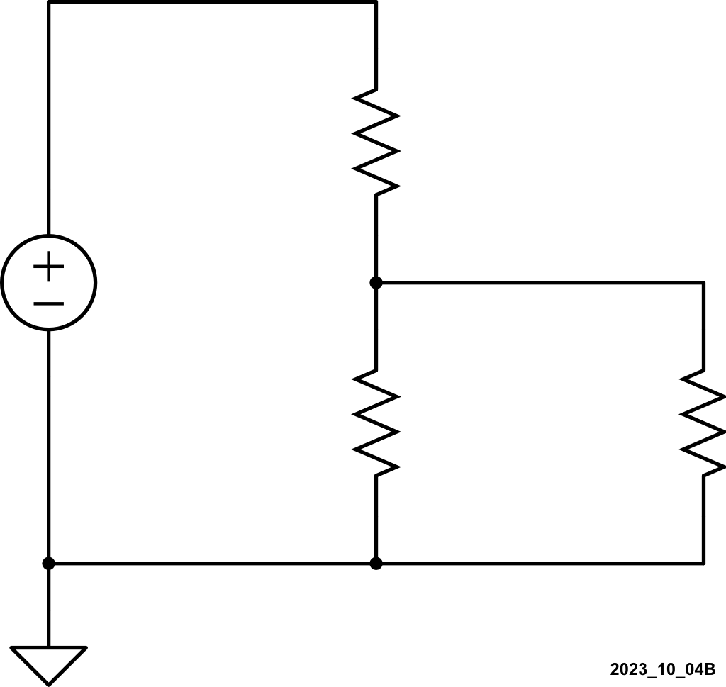
Kirchhoff’s Current Law:
What goes in, has to come out
I₁ = I₂ + I₃
R₁
I₁
I₂
I₃
R₂
R₃

Slide 18
Ohm’s Law, KVL, and KCL:
I₁
KVL
V_{SUPPLY} = ΔV₁ + ΔV_{OUT}
+
ΔV₁
–
R₁
V_{OUT}
I₂
V_{SUPPLY}
I₃
+
ΔV_{OUT}
–
R₂
R₃

Slide 19
Ohm’s Law, KVL, and KCL:
I₁
KVL and KCL
V_{SUPPLY} = ΔV₁ + ΔV_{OUT}
I₁ = I₂ + I₃
+
ΔV₁
–
R₁
V_{OUT}
I₂
V_{SUPPLY}
I₃
+
ΔV_{OUT}
–
R₂
R₃

Slide 20
Ohm’s Law, KVL, and KCL:
I₁
KVL and KCL and Ohm’s Law
V_{SUPPLY} = ΔV₁ + ΔV_{OUT}
I₁ = I₂ + I₃
ΔV₁ = I₁R₁
ΔV_{OUT} = I₂R₂ = I₃R₃
+
ΔV₁
–
R₁
V_{OUT}
I₂
V_{SUPPLY}
I₃
+
ΔV_{OUT}
–
R₂
R₃

Slide 21
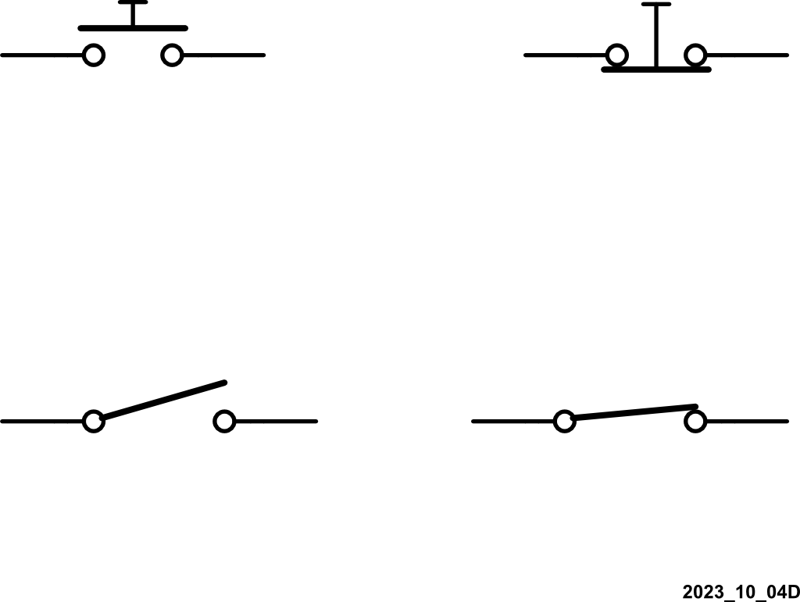
Buttons and Switches: Normally Open or Normally Closed
Normally Open Button
(Push to Close)
Normally Closed Button
(Push to Open)
Normally Open Switch
(Push to Close)
Normally Closed Switch
(Push to Open)

Slide 22
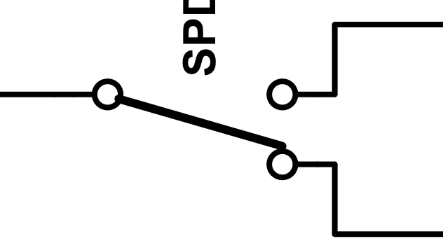
Engineering: “Doing Something Better”
Singe
Pole (SP)
Normally Open
Single Throw
(ST)
SPST-NO
Poles: an electrically separate connection
Each pole is a separate circuit
Throw: separate wiring paths (other than "open") that the switch can connect two
ST: Switch is open or closed
DT: Switch is connected to “OUT1” or “OUT2”
Singe
Pole (SP)
Normally Closed
Single Throw
(ST)
SPST-NC
Singe
Pole (SP)
DualThrow
(DT)
SPDT

Slide 23
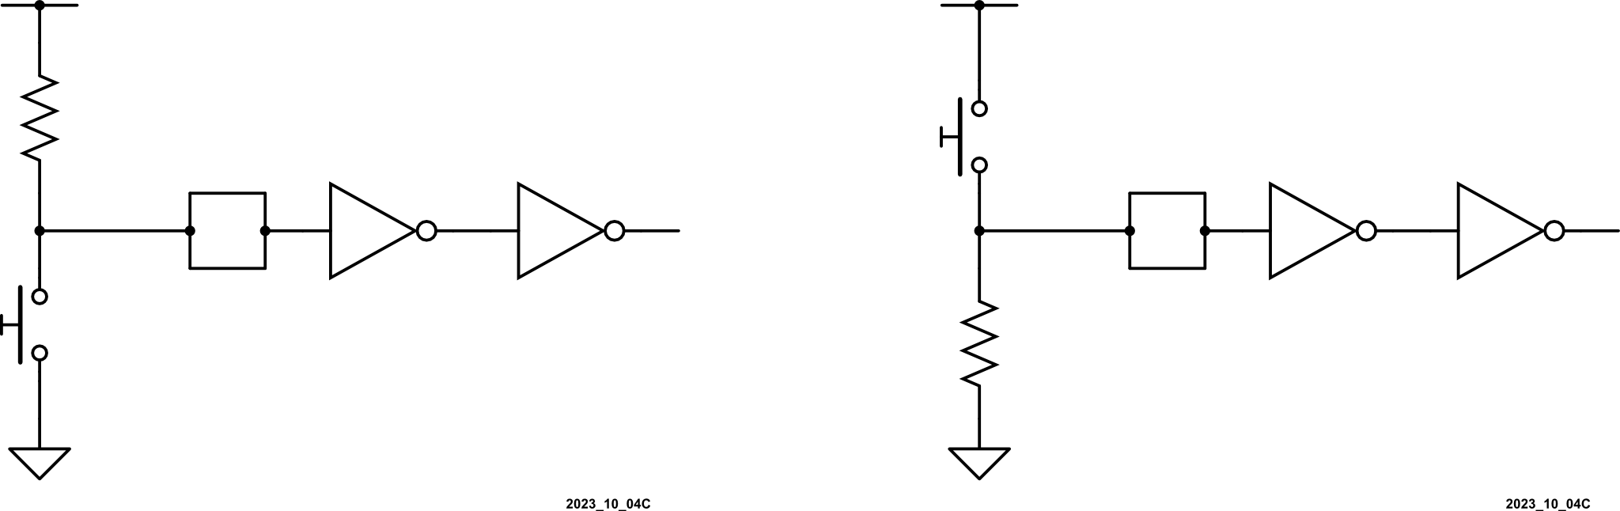
Buttons and Switches: Need Pull-Up or Pull-Down Resistors
V_{DD}
V_{DD}
IN
MCU
Pin
IN
IN
IN
MCU
Pin
IN
IN

Slide 24
Buttons and Switches: Need Pull-Up or Pull-Down Resistors Switches Open
V_{DD}
V_{DD}
0A
IN
MCU
Pin
IN
IN
IN
MCU
Pin
IN
IN
0A

Slide 25
Buttons and Switches: Need Pull-Up or Pull-Down Resistors Switches Open
V_{DD}
V_{DD}
0A
IN
MCU
Pin
IN
IN
IN
MCU
Pin
IN
IN
0A
0A
0A

Slide 26
Buttons and Switches: Need Pull-Up or Pull-Down Resistors Switches Open
V_{DD}
V_{DD}
0A
0A
IN
MCU
Pin
IN
IN
IN
MCU
Pin
IN
IN
0A
0A
0A
0A

Slide 27
Buttons and Switches: Need Pull-Up or Pull-Down Resistors Switches Open
V_{DD}
V_{DD}
0A
+
0V
–
0A
IN
MCU
Pin
IN
IN
IN
MCU
Pin
IN
IN
+
0V
–
0A
0A
0A
0A

Slide 28
Buttons and Switches: Need Pull-Up or Pull-Down Resistors Switches Open
V_{DD}
V_{DD}
0A
+
0V
–
0A
0V
IN
IN
IN
V_{DD}
IN
IN
IN
MCU
Pin
MCU
Pin
+
0V
–
0A
0A
0A
0A

Slide 29
Buttons and Switches: Need Pull-Up or Pull-Down Resistors Switches Open or Switches Closed
V_{DD}
V_{DD}
+
0V
–
IN
MCU
Pin
IN
IN
IN
MCU
Pin
IN
IN
+
0V
–

Slide 30
Buttons and Switches: Need Pull-Up or Pull-Down Resistors Switches Open or Switches Closed
V_{DD}
V_{DD}
+
0V
–
IN
IN
IN
0V
IN
IN
IN
MCU
Pin
MCU
Pin
V_{DD}
+
0V
–

Slide 31
Buttons and Switches: Need Pull-Up or Pull-Down Resistors Switches Open or Switches Closed
V_{DD}
V_{DD}
+
0V
–
IN
IN
IN
0V
IN
IN
IN
MCU
Pin
MCU
Pin
V_{DD}
+
0V
–
0A
0A

Slide 32
Buttons and Switches: Need Pull-Up or Pull-Down Resistors Switches Open or Switches Closed
V_{DD}
V_{DD}
I
I
I = V_{DD} / R
P_{loss} = I ²R
+
0V
–
IN
IN
IN
0V
IN
IN
IN
MCU
Pin
MCU
Pin
V_{DD}
+
0V
–
0A
0A
I = V_{DD} / R
P_{loss} = I ²R

Slide 33
Driving LEDs from Logic Gates (and hence Port Bit Outputs)
V
S
current flows out of the gate
and lights led when output
I
is at logic 1
R
D
R
current flows into gate
and lights led when
V
D
output is at logic 0
V
I
D
D
a) Gate Output Sourcing b) Gate Output Sinking
Current to LED Current from LED
Data for the 16F84A (when powered from 5V) shows an output resistances of approximately 130Ω when at logic high, and 36Ω when at logic 0.

Slide 34
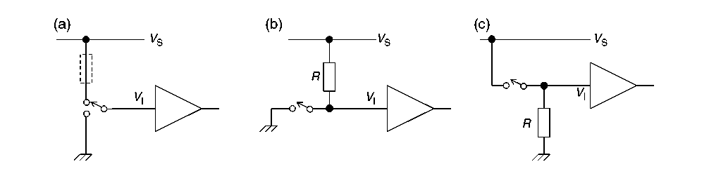
Simple Digital Interfacing – connecting to switches
Connecting switches to logic inputs. (a) SPDT connection. (b) SPST with pull-up resistor.
(c) SPST with pull-down resistor
Notes:
SPDT: Single Pole Double Throw (SPDT)

Slide 35
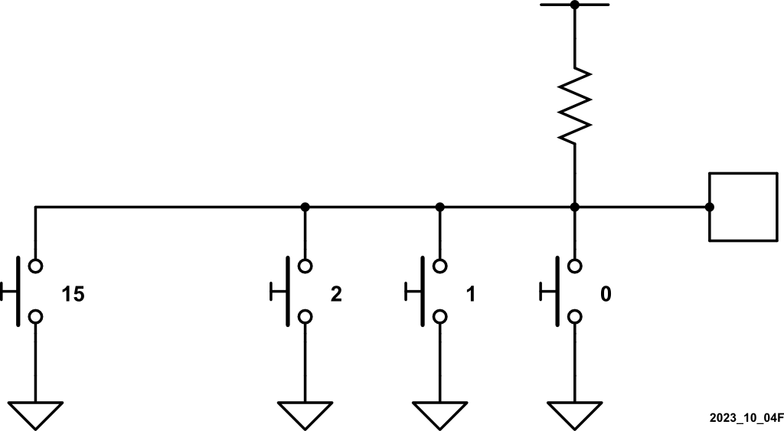
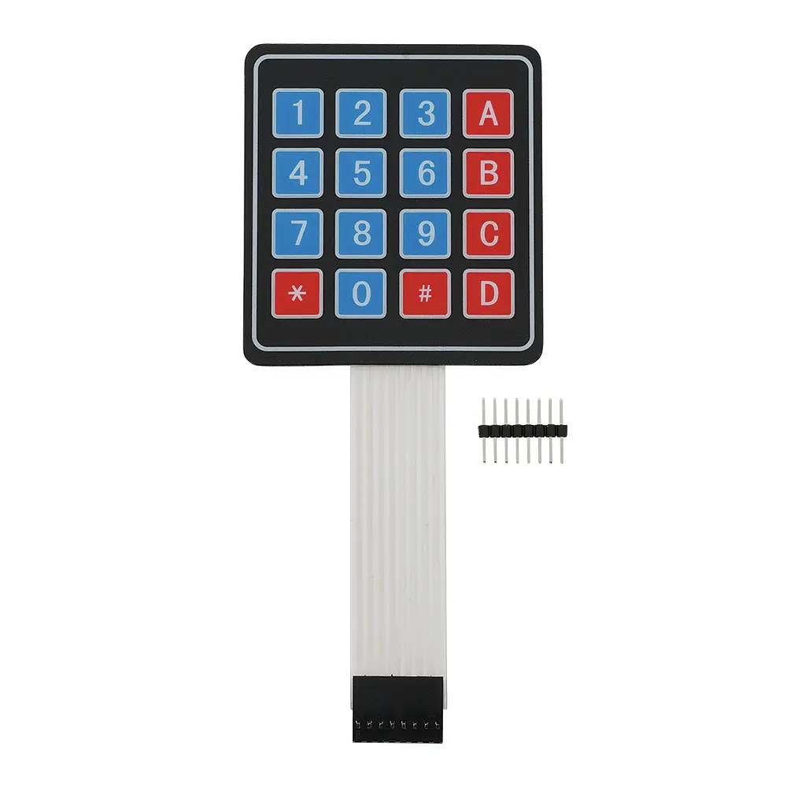
Keypads: Detect Any Button Pressed
V_{DD}
IN
MCU
Pin
….

Slide 36
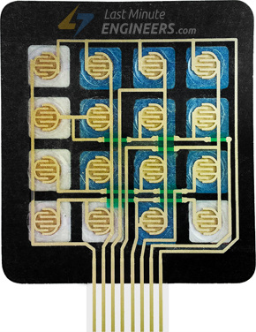
Keypads: Detect Each Button Pressed
“0”

Slide 37
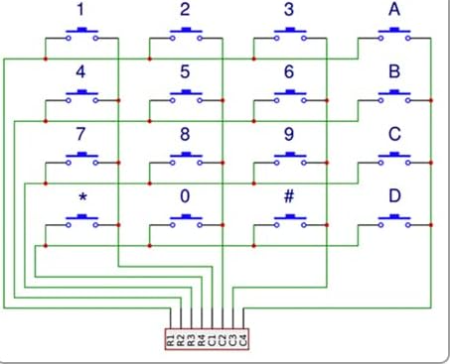
Keypad Decoder Circuit

Slide 38
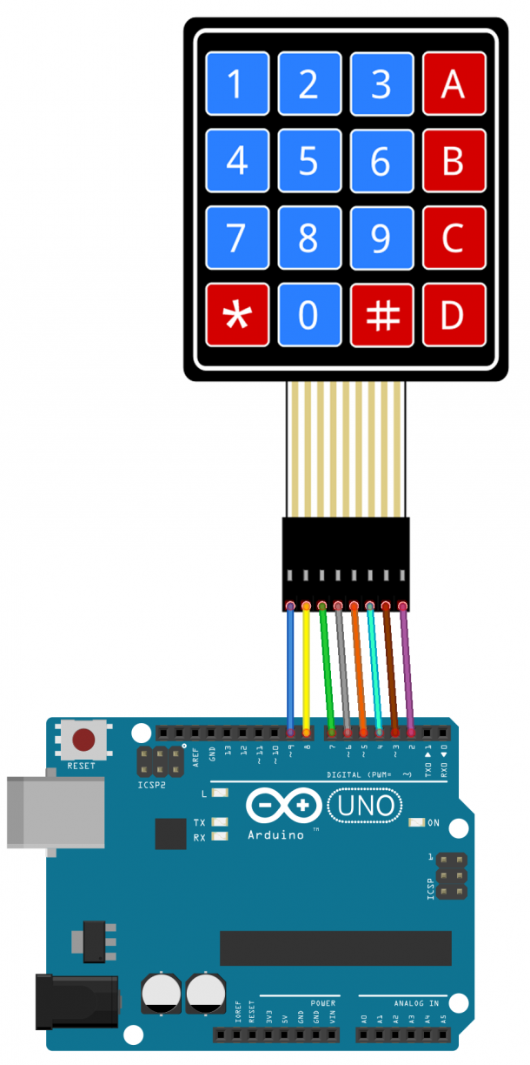
Keypad Decoder Circuit
COL1
COL2
COL3
COL4
ROW1
ROW2
ROW3
Use internal
pull-up
resistors
ROW4

Slide 39
Keypad Decoder Circuit
COL1
COL2
COL3
COL4
ROW1
ROW2
ROW3
Use internal
pull-up
resistors
ROW4

Slide 40
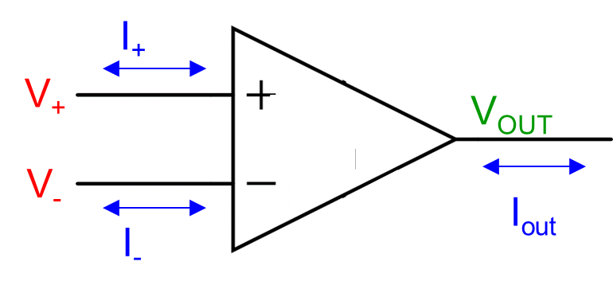
Making Input Signals Bigger with Operational Amplifiers (Op Amps)
Ideal Operational Amplifier MODEL 1) V₊ = V₋ 2) I₊ = I₋ = 0A 3) V_{OUT} makes 1 and 2 true

Slide 41
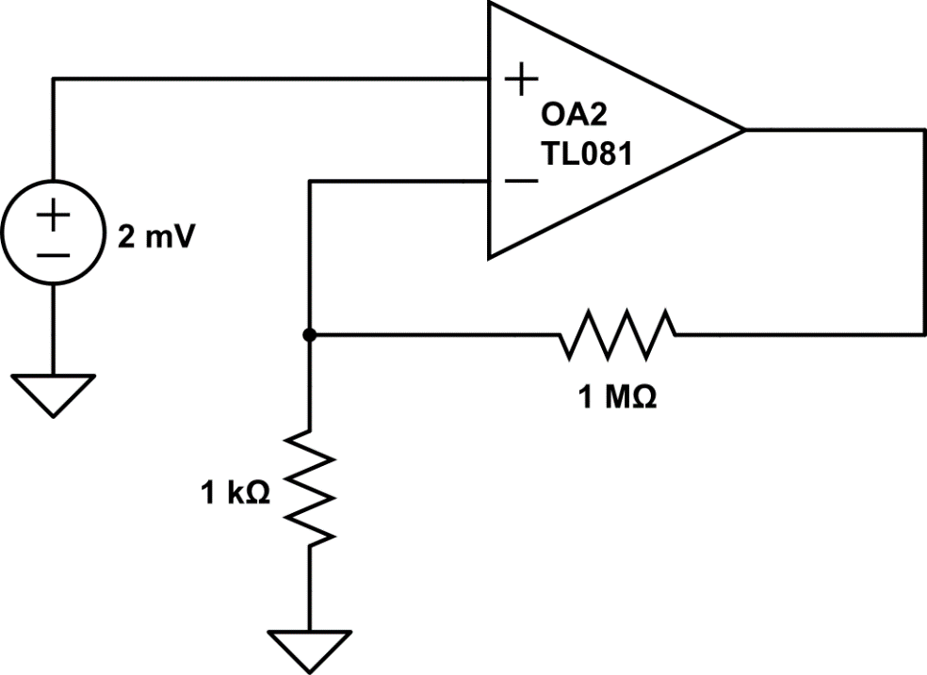
Making Small Analog Signals Bigger
V_{OUT}
2mV
1MΩ
1kΩ
Notes:
Here’s an operational amplifier circuit. We are asked to analyze the circuit to find the voltage, the V out, at the output pin.
Again, using our three laws of ideal Op amps, Ohm’s law, KCl, and KVL, this is pretty straightforward. But again, it does have a number of small steps.

Slide 42
Making Small Analog Signals Bigger
V_{OUT}
2mV
1MΩ
0mV
1kΩ
0mV
Notes:
To begin with, I always look for any ground connections in the circuit.
If no node has been designated as ground, feel free to pick one.
Here, we have two grounds indicated in our circuit. Go ahead and label all of the grounds potential at 0 V.

Slide 43
Making Small Analog Signals Bigger
V_{OUT}
2mV
1MΩ
0mV
1kΩ
0mV
Notes:
Next, I usually look to see if there are any voltage sources. Remember, voltage sources just have one job.
And this two millivolt source?

Slide 44
Making Small Analog Signals Bigger
2mV
V_{OUT}
2mV
1MΩ
0mV
1kΩ
0mV
Notes:
It just boosts the potential as positive terminal to a positive 2 mV. That’s it’s one job

Slide 45
Making Small Analog Signals Bigger
1) V₊ = V₋
2mV
V_{OUT}
2mV
2mV
1MΩ
0mV
1kΩ
0mV
Notes:
Awesome. Let’s remember, the first rule of ideal op amps. The V positive and the negative terminals will be at the same potential.
Therefore, the V negative terminal must also be at a potential of positive 2 mV. That’s just how operational amplifier circuits work

Slide 46
Making Small Analog Signals Bigger
1) V₊ = V₋
2) I₊ = I₋ = 0A
0A
2mV
V_{OUT}
0A
2mV
2mV
1MΩ
0mV
1kΩ
0mV
Notes:
Next,, we also know that 0A of current flows into or out of either one of the two op amp inputs. Therefore, we write I positive is equal to I negative is equal to 0A.
At times, this is drawn as a bidirectional arrow like this.

Slide 47
Making Small Analog Signals Bigger
1) V₊ = V₋
2) I₊ = I₋ = 0A
3) V_{OUT} makes 1 and 2 true
0A
2mV
V_{OUT}
0A
2mV
2mV
1MΩ
0mV
1kΩ
0mV
Notes:
Now let’s look at the third rule of ideal operatives. The voltage at the op amp output will adjust itself to make the V- input pin 2 mV, the same as V positive.
Okay, but how does it do that?
We may not know yet, but we can figure it out with some combination of Ohm’s law, KCl and KVL.

Slide 48
Making Small Analog Signals Bigger
1) V₊ = V₋
2) I₊ = I₋ = 0A
3) V_{OUT} makes 1 and 2 true
0A
2mV
V_{OUT}
0A
2mV
2mV
1MΩ
I_{B}
0mV
I_{A}
1kΩ
0mV
Notes:
Let’s go ahead and label currents flowing through the 1 kohm and 1Mohm resistor. We don’t values are yet, but we expect that we will have some current. Therefore, we just give them temporary names of I sub A and I sub B.

Slide 49
Making Small Analog Signals Bigger
1) V₊ = V₋
2) I₊ = I₋ = 0A
3) V_{OUT} makes 1 and 2 true
0A
By Ohm’s Law:
I_{A} = (2mV – 0V)/1kΩ = 2μA
2mV
V_{OUT}
0A
2mV
2mV
1MΩ
I_{B}
0mV
I_{A}
1kΩ
0mV
Notes:
We actually have all the information we need to calculate the current I A. We can simply use Ohm’s law.
The current IA flows down from a potential of 2 mV to ground, or 0 V. That’s a positive 2 mV drop across a 1 kohm resistor.
By Ohm’s law, 2mV divided by 1kohm gives us a current IA equal to positive 2 µA.
2 µA may seem fairly small, and some students worry if their answers look like this. However, that’s one of the huge advantages of operational amplifiers. They can work on very very low current levels, and therefore, they can be quite energy efficient.

Slide 50
Making Small Analog Signals Bigger
1) V₊ = V₋
2) I₊ = I₋ = 0A
3) V_{OUT} makes 1 and 2 true
0A
By Ohm’s Law:
I_{A} = (2mV – 0V)/1kΩ = 2μA
2mV
V_{OUT}
0A
2mV
2mV
1MΩ
I_{B}
0mV
I_{A} = 2μA
1kΩ
0mV
Notes:
So let’s go ahead and put the 2 µA of current down on our schematic.

Slide 51
Making Small Analog Signals Bigger
1) V₊ = V₋
2) I₊ = I₋ = 0A
3) V_{OUT} makes 1 and 2 true
0A
By Ohm’s Law:
I_{A} = (2mV – 0V)/1kΩ = 2μA
2mV
V_{OUT}
0A
2mV
2mV
1MΩ
I_{B}
0mV
I_{A} = 2μA
1kΩ
0mV
Notes:
Hey, with this new information, we know two of the three currents flowing into this node.

Slide 52
Making Small Analog Signals Bigger
1) V₊ = V₋
2) I₊ = I₋ = 0A
3) V_{OUT} makes 1 and 2 true
0A
By Ohm’s Law:
I_{A} = (2mV – 0V)/1kΩ = 2μA
Since I₋ = 0A:
By KCL:
2mV
V_{OUT}
0A
2mV
2mV
1MΩ
I_{B}
0mV
I_{A} = 2μA
1kΩ
0mV
Notes:
KCl is actually pretty simple here, since one of the three currents is 0 A.

Slide 53
Making Small Analog Signals Bigger
1) V₊ = V₋
2) I₊ = I₋ = 0A
3) V_{OUT} makes 1 and 2 true
0A
By Ohm’s Law:
I_{A} = (2mV – 0V)/1kΩ = 2μA
Since I₋ = 0A:
By KCL: I_{A} = I_{B} = 2μA
2mV
V_{OUT}
0A
2mV
2mV
1MΩ
2μA=I_{B}
0mV
I_{A} = 2μA
1kΩ
0mV
Notes:
That means that the current IB must be equal to the current IA. They are both 2 µA!

Slide 54
Making Small Analog Signals Bigger
1) V₊ = V₋
2) I₊ = I₋ = 0A
3) V_{OUT} makes 1 and 2 true
0A
By Ohm’s Law:
I_{A} = (2mV – 0V)/1kΩ = 2μA
Since I₋ = 0A:
By KCL: I_{A} = I_{B} = 2μA
2mV
V_{OUT}
0A
2mV
– ΔV +
2mV
1MΩ
2μA=I_{B}
0mV
I_{A} = 2μA
1kΩ
0mV

Slide 55
Making Small Analog Signals Bigger
1) V₊ = V₋
2) I₊ = I₋ = 0A
3) V_{OUT} makes 1 and 2 true
0A
By Ohm’s Law:
I_{A} = (2mV – 0V)/1kΩ = 2μA
Since I₋ = 0A:
By KCL: I_{A} = I_{B} = 2μA
By Ohm’s Law:
2mV
V_{OUT}
0A
2mV
– ΔV +
2mV
1MΩ
2μA=I_{B}
0mV
I_{A} = 2μA
1kΩ
0mV
Notes:
You bet. A total of 2 µA is flowing through the 1 megohms resistor.
That 2 µA of current is flowing from the output voltage, V out, down to a potential of positive 2 mV.
Therefore, the voltage change across the resistor must be equal to V out -2 mV.
By Ohm’s law we have V out -2 mV must be equal to 2 µA times one Mohm

Slide 56
Making Small Analog Signals Bigger
1) V₊ = V₋
2) I₊ = I₋ = 0A
3) V_{OUT} makes 1 and 2 true
0A
By Ohm’s Law:
I_{A} = (2mV – 0V)/1kΩ = 2μA
Since I₋ = 0A:
By KCL: I_{A} = I_{B} = 2μA
By Ohm’s Law:
2mV
V_{OUT}
0A
2mV
– ΔV +
2mV
1MΩ
2μA=I_{B}
0mV
I_{A} = 2μA
1kΩ
0mV
Notes:
Solving this equation, we calculate an op amp output voltage of 2.002 Volts.
We did it!
This circuit is multiplying the very small input signal of 2 mV over 1000 to create an output voltage of 2.002 V.
Hooray!

Slide 57
Modelling a Logic Gate Output
To connect the port bit output, we need an understanding of how its internal circuit behaves electrically. We can model it as shown.
internal Logic 1 voltage
switch is in this
is the supply voltage
position when
V
output is at Logic 1
V
LH
R
S(high)
V
S
R
S(high)
V
L
L
R
S(low)
R
S(low)
V
LL
switch is in this
position when
output is at Logic 0
internal Logic 0
voltage is ground
a) Generalised Model b) Model of CMOS Logic Gate Output

Slide 58

SFRs for the 16F84A Parallel Ports
The Port SFRs can be seen in the memory map, the detail repeated here.
SFR named PORTX holds the input/output data for the port, ie it holds all the “Data Latch” bits for that port.
The SFR named TRISX holds all the “TRIS Latch” bits for that port. The bits can be set independently, so one can be input while another output. They cannot be both at the same time.
Ports A and B can easily be found on the pin connection diagram. Port A is only 5 bits, while Port B is 8.
Note that some pins have several functions, as indicated on the diagram.

